Slide 1


Presenting by:
P. Roopavani
B. Yashmitha
B. Bhuvaneswari
P. Likitha
U. Praneetha

Slide 2
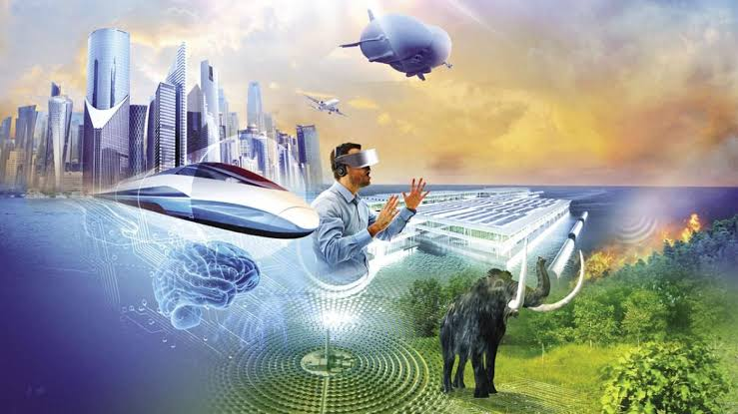
🌏🚀 Future tech and exploration
🌏🚀Future Tech and
Exploration

Slide 3

“Future Tech” — Future tech refers to advance tools, machines, and innovations that are still developing or expected to emerge in the coming years.
“Exploration” — The discovery and study of new frontliers in the futures, exploration goes beyond earth and also into unknown areas of sciences & technologies.

Slide 4


🚀1. Space Exploration
Mars Colonization - NASA, SpaceX, and others are developing crewed missions to Mars by the 2030s.
Asteroid Mining - Companies are researching how to extract rare metals and water from asteroids for use in space and on Earth.
👩‍⚕️2. Medical Advancements
Cures for currently incurable diseases and longer life expectancy & improved quality of life.

Slide 5

🤖3.Artificial Intelligence and Robotics
>>Autonomous systems - AI-powered robots will handle space exploration, deep-sea research, and disaster recovery where humans can’t survive.
>>Human-Robot-Collaboration– Cobots(Collaborative robots) will work with humans in factories, hospitals, and exploration missions.
>>Personal-AI-assistants-More advanced than today’s Chat GPT or siri, these will act as lifelong companions and co-workers.

Slide 6

Challenges for future tech and exploration:
1. Job Displacement & Inequality
Automation/robots replacing human jobs. Wealth gap may widen, if tech benefits are equally distributed.
2. Privacy and security risks
Cybersecurity threats(hacking, data leaks). Mass surveillance & loss of individual privacy.
3. Existential Risks
AI superintelligence becoming uncontrollable and space collonization risks(radiation, unknown environments).

Slide 7
3. Deep Ocean Exploration
Submarines and equipment must withstand crushing pressure at great depths.
Salt water corrosion and limited visibility complicate exploration.
Exploring without harming fragile marine life.

Slide 8

Why the future tech and exploration is more important in future?
1. Solving global challenges
Climate change, food shortages, energy crises & pandemics need innovative solutions.
2. Advancing Human health & longevity
Medical technologies like gene editing, Nano technologies that can improve quality of life.
3. Economic growth & Jobs
New industries (AI, robotics, space mining, green energy).

Slide 9

Conclusion
Future tech and exploration are not just tools of progress but necessities for human survival and growth .
They hold the power to solve global
problems, Improve health, drive economies on Earth. By investing in future technologies and exploration today, we prepare humanity for a safer, smarter & more sustainable tomorrow.

Slide 10


